Slide 1
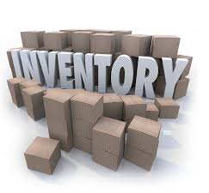

IS 436 Deliverable 1: Retail Inventory System
Leader Justin Chan
QA Parmeet Dua
Programmer Brandon Nguyen
Analyst Urgy Eado
QA Support Jaime Pineda
Project Manager Rafay Khurram
Editor Raj Desai

Slide 2

System Introduction
A retail store is in need of an inventory system to efficiently keep track of their items. They want to implement a system that can be maintained and is reliable enough to analyze attributes of items as well. We will design and create the system for the store.

Slide 3
System Request
Project Sponsor: Our sponsors will be companies who are looking for ways to more efficient ways to manage their inventory, to increase time management within an organization.
Business Need: An inventory system is needed in order for the business to efficiently keep track of each of its items, in order to gain valuable data regarding item sell through and restock rates.
Business Benefits: The Inventory system will allow for greater response time as well as the ability to keep track of all the inventory on a daily basis. This will be beneficial when keeping track of the value of items on hand and quantity.
Business solution: Many items leave and enter the warehouse on a daily basis so an inventory management system is absolutely essential in order to keep track of them all.

Slide 4
Business Requirements
The company should be able to use the inventory system to track each of its available items, along with other functionality such as:
Sales forecasting - Being able to accurately predict and react to customer demand based on any particular item’s sell through rate.
Production Planning - Manufacturers will be able to view the sales forecast and know which items sell exactly how much from the business.
Material Requirement Planning - An inventory management system will also allow for a better insight into what items sell more so that manufacturers can plan their product output much more efficiently as well.

Slide 5
Business Value
An inventory system will dramatically increase sales for the business once proper inventory analysis has been done.
The inventory management system will also benefit manufacturers, who will be privy to the insight gained from the IMS as well, allowing them to adjust manufacturing accordingly.
An inventory management system will also minimize any manual tracking done by humans such as bookkeeping, allowing for more resources and money saved for the business.

Slide 6
Special Issues
This inventory management system will be a worthwhile asset to the business, allowing for simpler, yet more efficient production, and faster item management.
The system should be fully implemented within the next 3 months.

Slide 7
Feasibility Analysis - Technical Feasibility
Users’ familiarity with a retail inventory system: It is unknown exactly just how familiar the users of our system are, however since they have a general idea of the technology and are tech savvy it’s assumed that they’ll have no problem using such a system.
Lack of familiarity with technology: The members of the group haven’t built a retail inventory system before, though the technology is quite common.
Project Size: 7 members
Project Time: Near the end of the semester
Compatibility with existing systems: No current systems exist

Slide 8
Feasibility Analysis - Economic Feasibility
Costs: Roughly 2 hours a week per member.
Benefit: A good grade in IS 436. Added experience with various technologies and working in a team to create a project.
Cash Flow: None
Financial Viability: Completely viable

Slide 9
Feasibility Analysis - Organizational Analysis
Strategic Alignment: The business aims to be successful and efficient at what they do. An inventory management system will help them be just that.
Benefits of System: Allow for easier tracking and management of inventory. System will allow for further data analysis to be conducted once large data sets have been processed into the system. This will help upper management with future business decisions.

Slide 10
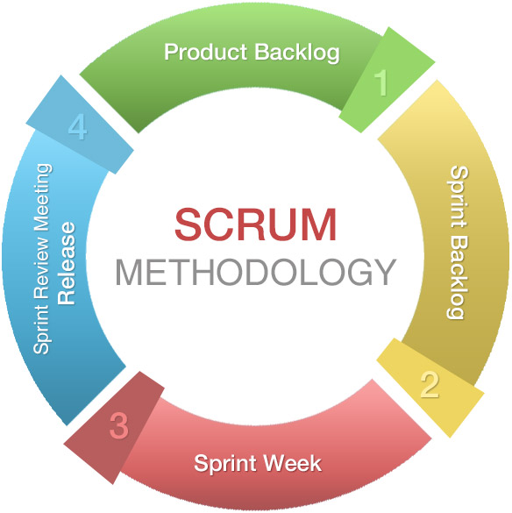
Project Methodology - Scrum
This Agile Framework allows for:
Short Cycles
Quick development and testing
Better communication and collaboration
Incorporating client feedback

Slide 11
Why Scrum?
It’ll be beneficial since the retail environment is dynamic and always changing.
Keeps a prioritized list of the project requirements such as product planning, sales forecasting, and material requirement planning functions of the final project
Allows for well communication within the team to help discuss any roadblocks or issues encountered in each cycle or “sprint".

Slide 12
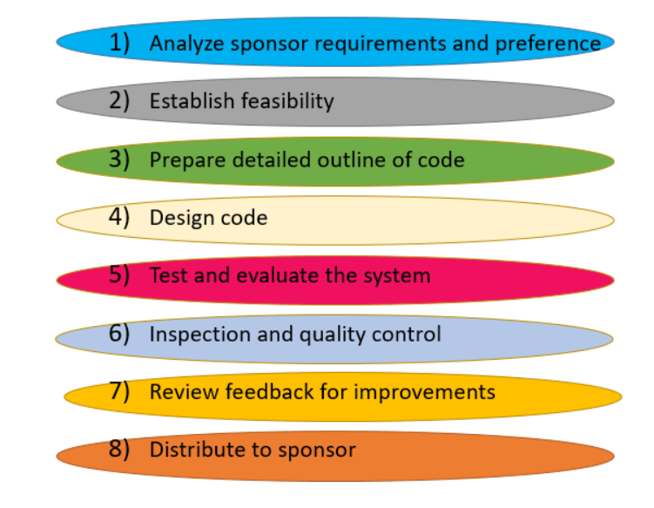
Work Plan
Feb Mar Apr May

